Slide 1
The Rise of Austria and Prussia (pgs. 569-576)
By Jack Anderson and Lizbeth Menez

Slide 2
Bohemian Estates
Czech nobility was largely Protestant and had more political power due to their domination in the Bohemian estates in 1600
1618 Bohemian estates had began a revolt in order to protect the Protestant rights but was shortly crushed in 1620 (Battle of White Mountain)
Following this revolt Ferdinand (Habsburg) reduced the power of Bohemian estates

Slide 3
Bohemian Estates (Continued)
Ferdinand also confiscated the land of a large number of Protestant nobility and gave it to Catholic nobility as appreciation of loyalty
Reorganization of Bohemia became another stepping stone towards absolutism

Slide 4
Ottoman Empire
Ottoman Empire began in Modern-day Turkey and by 17th century had expanded to Northern Africa, Southern Asia, and Central Europe
Predominantly a Muslim Empire, although there was religious toleration in certain provinces
Waged war against the Catholic Church and the Hapsburg family
Lost control of Hungary in an attempt to siege Vienna in 1683

Slide 5
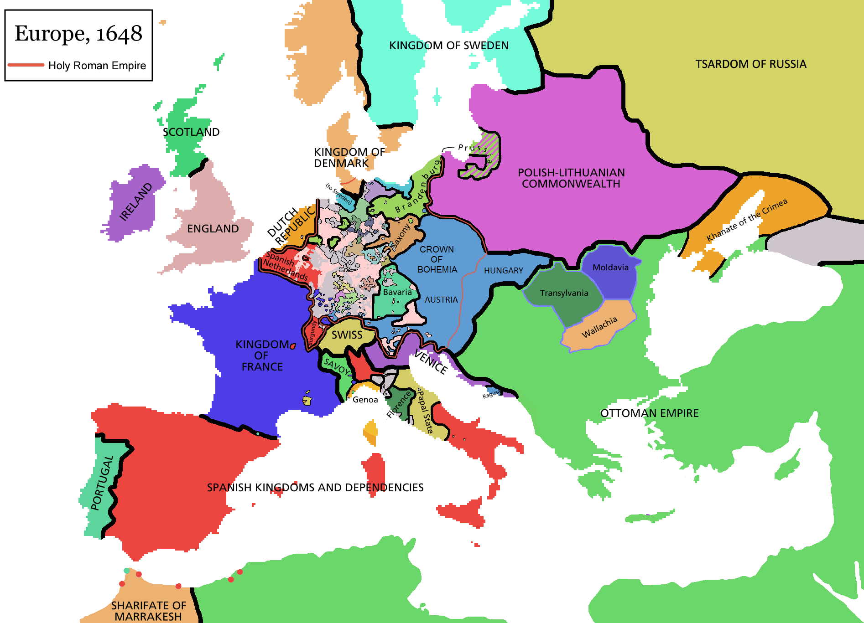
Hungary
After being separated from the Ottoman Empire, the Hapsburg’s gained control of the area
The people of Hungary (mostly Protestant) were used to the religious toleration from the Turks, and resisted the Hapsburg’s attempts to re-Catholize
Fought for independence from the Hapsburg’s, and even though they eventually lost, they secured a compromise from the government where Hungarian privileges were restored

Slide 6
Prussia in the 17th century
even though Prussia had been conquered by Germany in the 13th century( Teutonic knights), by 1600 both Prussian and Polish peasants had a majority of their rights reduced and revoked by their noble landlords
1618 after the Hohenzollern family died out Prussia reverted to the election of Brandenburg
when Frederick William came into power (1640-1688) he was determined to unify the three separate provinces

