Slide 1
The Renaissance and Reformation
By: Lizbeth Menez

Slide 2
The Renaissance
The renaissance lasted from the mid 14th century until about the 17th century.
The renaissance era was a cultural rebirth, where standards of society and values shifted
During the renaissance the most affected aspects were art, architecture, and philosophy
During the renaissance the idea of a well rounded man included someone who is an active member of society, is well educated, extremely talented in music, and art, and overall have a “good” body (healthy, lean/fit)

Slide 3
The Renaissance (continued)
During this time art became more realistic, and perfection, along with attention to detail were major aspects.
Sculptures also tried to reflect the ideal physical characteristics that men, or women should possess.
Architecture also changed and became more symmetric, and with large attention to detail
People began to value knowledge and a good education more and with that can scientific and mathematical advances.

Slide 4
The Reformation
Was the movement that started in the 16tg century that began to stray from the traditional Roman Catholic Church
It began with Martin Luther, who was the first to successfully spectate with his works of the Ninety-Five Theses creating the Lutherans.
From Martin Luther, followed John Calvin creating the Calvinists.
From the original two reformed groups other groups branched out such as the Puritan and the Baptis

Slide 5
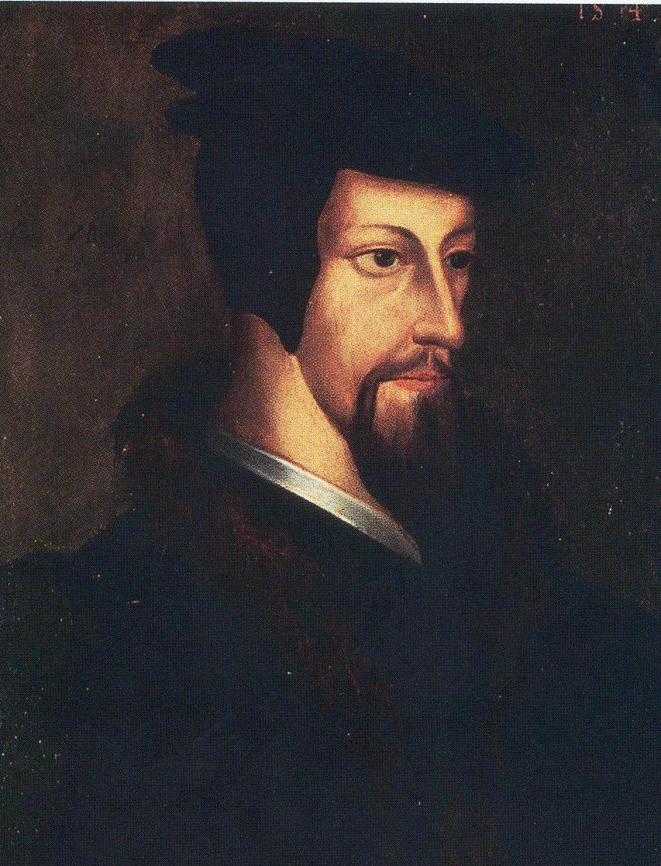
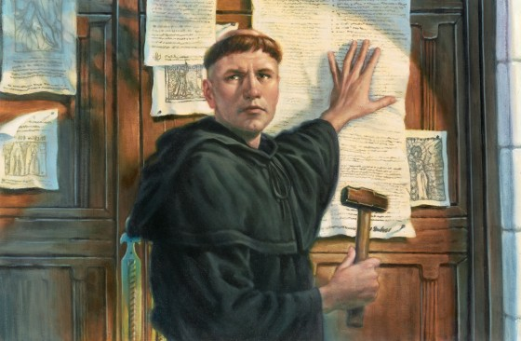
The Reformation (continued)
Martin Luther’s original conflicts with the church began with his outspoken disapproval of the selling of indulgences because he believed that the pope had no authority over purgatory. Luther also believed that salvation and eternal life aren't earned through good deeds but predetermined destiny. Biggest contribution was translating the bible into the vernacular using the printing press.

Slide 6
While several other reformed religions branched out from the Lutherans, the Calvinists and Puritans kept most of the traditional catholic values and rituals of worship but shifting the importance of the bible, eternal salvation, take on indulgences and importance of the Eucharist.
The Catholic Church was obviously angered by the new coming religions so they would often excommunicate people associated with the reformation and in some states with strong ties to the Pope (the papal estates) did not support religious freedom. Which led to the 30 years war the last major religious war in history.Events that came with the reformation include the Spanish Inquisition, council of Trent, and Edict of Nantes.

