Slide 1
Eastern and Western European Absolutism
By Andrew Knowlton and Jack Anderson

Slide 2
Absolutism
Absolutism was a response to the religious wars, plagues, and destruction that plagued Europe.
Rulers who came to power were paranoid of losing it
Oppressed their people in fear of a coup

Slide 3
Constitutionalism
-Constitutionalism is the limitation of government by law
-Constitutionalism first existed in Western Europe because populations were Greater and Eastern Rulers were much stricter.

Slide 4
Western Europe
Monarchs in Western Europe claimed they were in power due to divine power bestowed upon them
This concept went practically unquestioned until the French coup against Louis XIV and the spark of the revolution

Slide 5
England
Despite a century of violence and struggle, England became one of the first constitutional monarchs.
England was wealthy due to agricultural advances, and dissolution of the monasteries
1688-89 “Glorious Revolution” Parliament triumphs in peacefully switching king from James II to William and Mary effectively ending the divine right idea
1688 sovereignty established, Bill of rights created, and elections for parliament every three years. King may not interfere with law making.

Slide 6
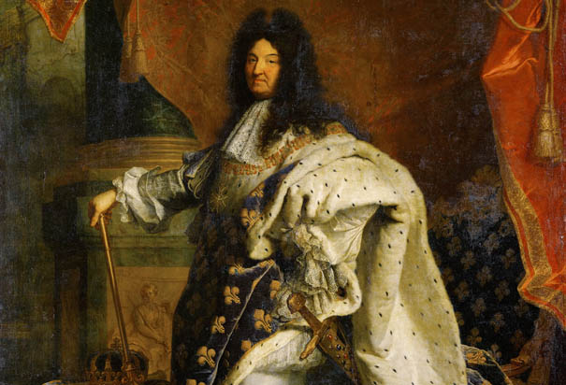
France
The people of France were led by absolute monarchs for most of the Middle Ages
Strong, paranoid monarchs like King Louis XIV ruled with an iron fist over his country

Slide 7
Eastern Europe
Serfdom: the bondage system between peasants and landowners
the serfdom system of labor was employed in Eastern Europe until the 19th century
Monarchs in Eastern European countries were particularly concerned with the French Revolution and its attempt to create a constitutional monarch
Wanted absolute and unquestioned power
oppressed people in order to achieve this

Slide 8
Prussia
In medieval times Eastern European monarch’s power was weakend by the nobles beneath them
In the middle ages, monarchs striped nobles of their political privileges and grabbed more power
- The Hohenzollern family took control in Prussia and bullied the nobles by collecting taxes without consent and building large armies
- Tried to emulate the absolutism in France

Slide 9
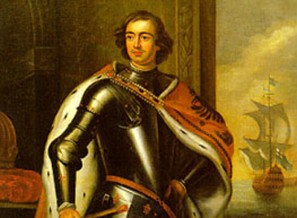
Russia
Peter the Great leads the Russian people with military power
Requires every noble to serve the military
Conducts foreign relations with the backing of strong, centralized military

Slide 10
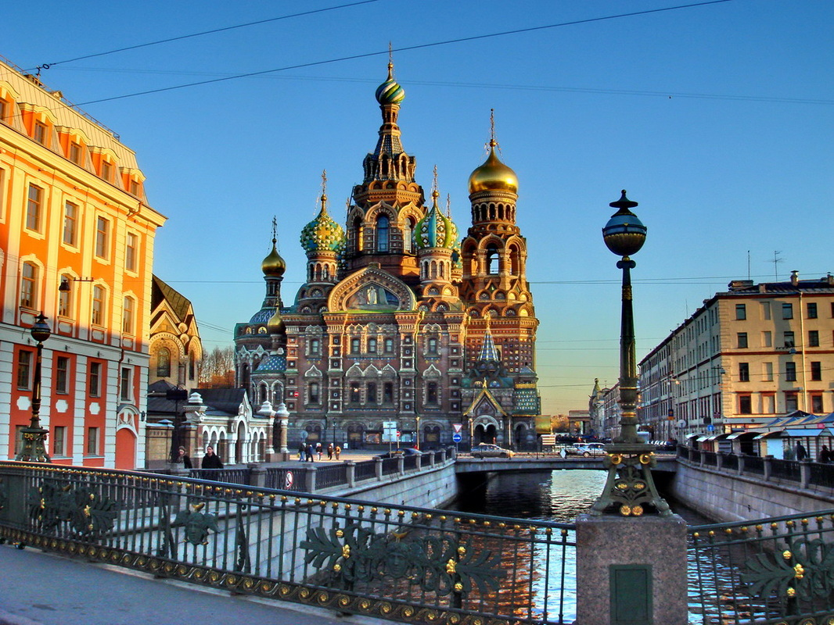
St Petersburg
Peter the Great has city built with the labor of peasants and heavy taxes on the wealthy

Slide 11
Differences between Eastern and Western Absolutism
Eastern Europe had very weak middle class and a powerful nobility class
Western Europe had a very strong middle class, but their nobility’s power was limited
Eastern European monarchs fought their way to power for the most part
Western European monarchs descended from royal families and were pre-accepted by the people

Slide 12
Similarities of Absolutism in Europe
Monarchs trying to enforce their absolutism faced strong opposition (from nobility in the East and from the middle class in the West)
Strong military support was essential to the survival of an absolutist monarchy
The people eventually would rally and challenge monarchy if they were living in poor conditions

