Slide 1
Absolutism and Baroque Architecture
Andrew²

Slide 2
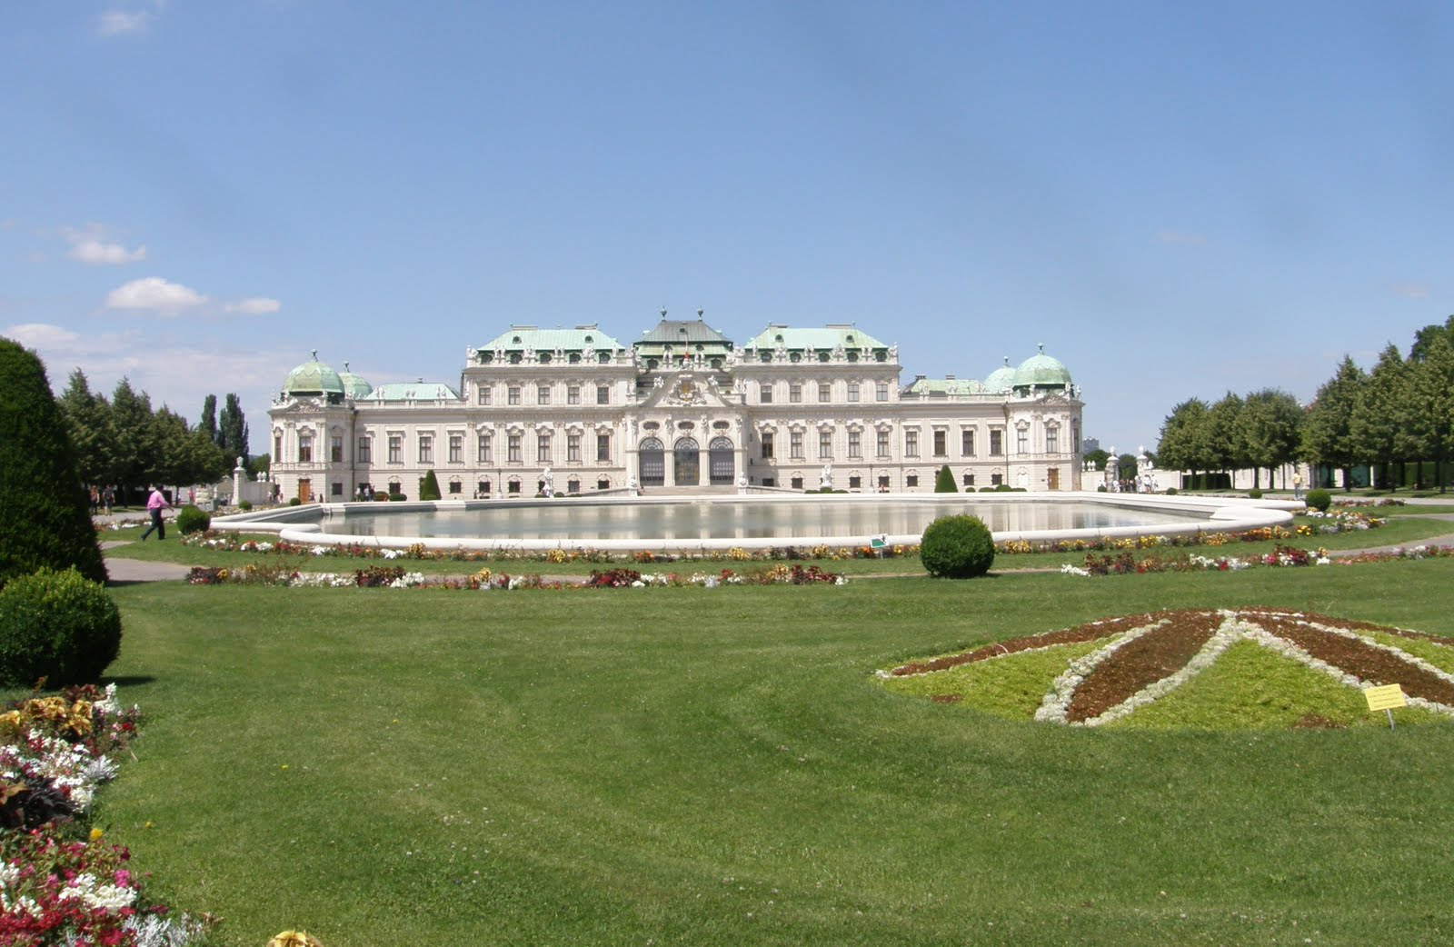
Palaces and Power
Baroque - exaggerated style focusing on grand scale and rich colors
Show wealth through palaces and wealth
Many mimicked Versailles and Louis XIV
Nobles backed by monarchies constructed palaces
Employed best architects of the day
Artistic achievement reflects political power

Slide 3
Royal Cities
Existing cities remodeled
Broad straight avenues centralized around palace or government buildings
Mathematical layouts and strict zoning/building laws
Expensive shops, department stores, window displays
Social classes separated by zones in cities
Beautiful carriages used in the streets (used as a sign of wealth)

Slide 4
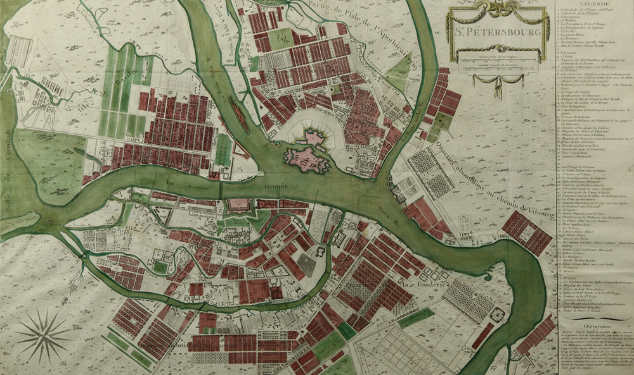
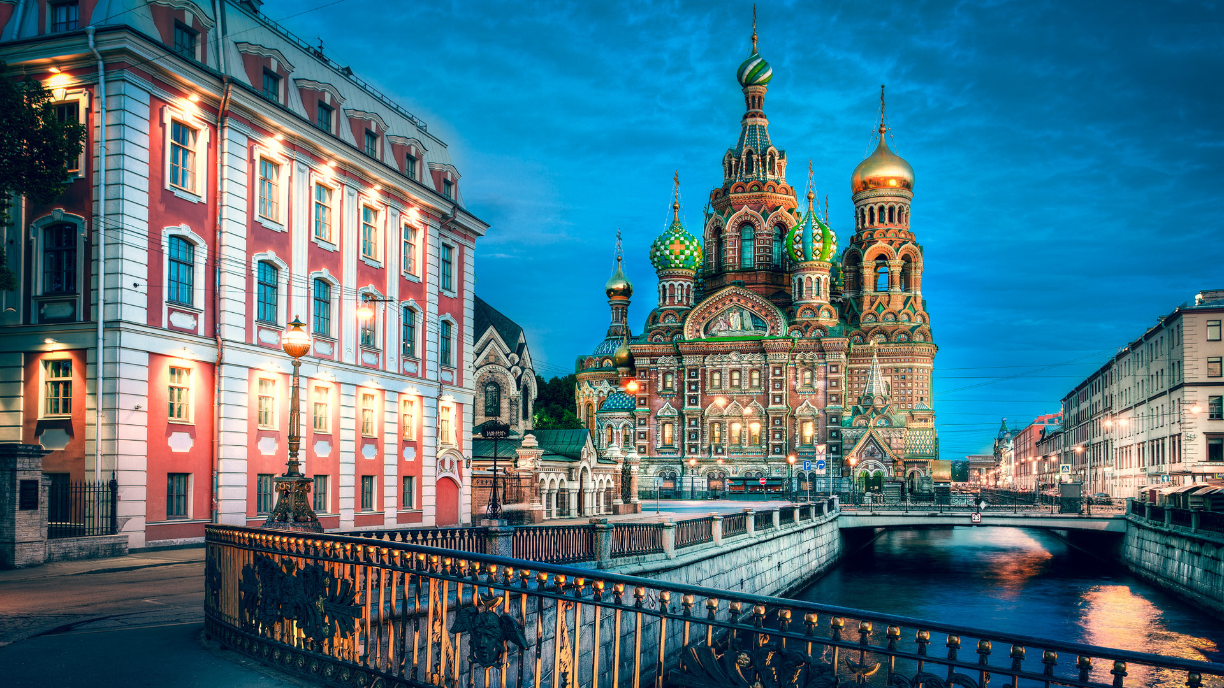
The Growth of St. Petersburg
St Petersburg was founded by the Tsar Peter the great in 1703 during the war between Russia and Sweden. After Russian victory, Peter amped up the construction
Peasants were drafted to build st petersburg. Every year of construction, ¼ to ⅓ of the forced laborers would flee.
Nobles were drafted to build more expensive houses that they would live in, and were required to pay for the cities avenues, parks, bridges, etc.
Peter wanted the city to be modern; paved avenues, ordered houses, parks, drainage canals, and lighting
Architectural regulations were put in place, and city sections were based on class (nobles and merchants separated from peasants)

