Slide 1
Austria and the Ottoman Empire
by Brian Chamberlain, Paul Long, and Liv Winnicki

Slide 2
Brief intro to the Ottoman Empire
founded in 1299 by Oghuz Turks under Osman I, started with the Turkish Tribes in Anatolia
Gained significant power and became a transcontinental after the Balkan Conquest by Murad I in 1362-1389
Ended the Byzantine Empire with the 1453 with the conquest of Constantinople
Under Osman the turkish borders extended to the east Mediterranean to the balkans
Peak at 15th and 16th century under Suleiman the Magnificent
included southeast Europe, Egypt, Hungary, Balkan, Greece, Ukraine, Iraq, Syria, Egypt, North Africa to Algeria
ottoman turks and Islam were the enemies to the Habsburgs because Ottomans were more religiously tolerant

Slide 3
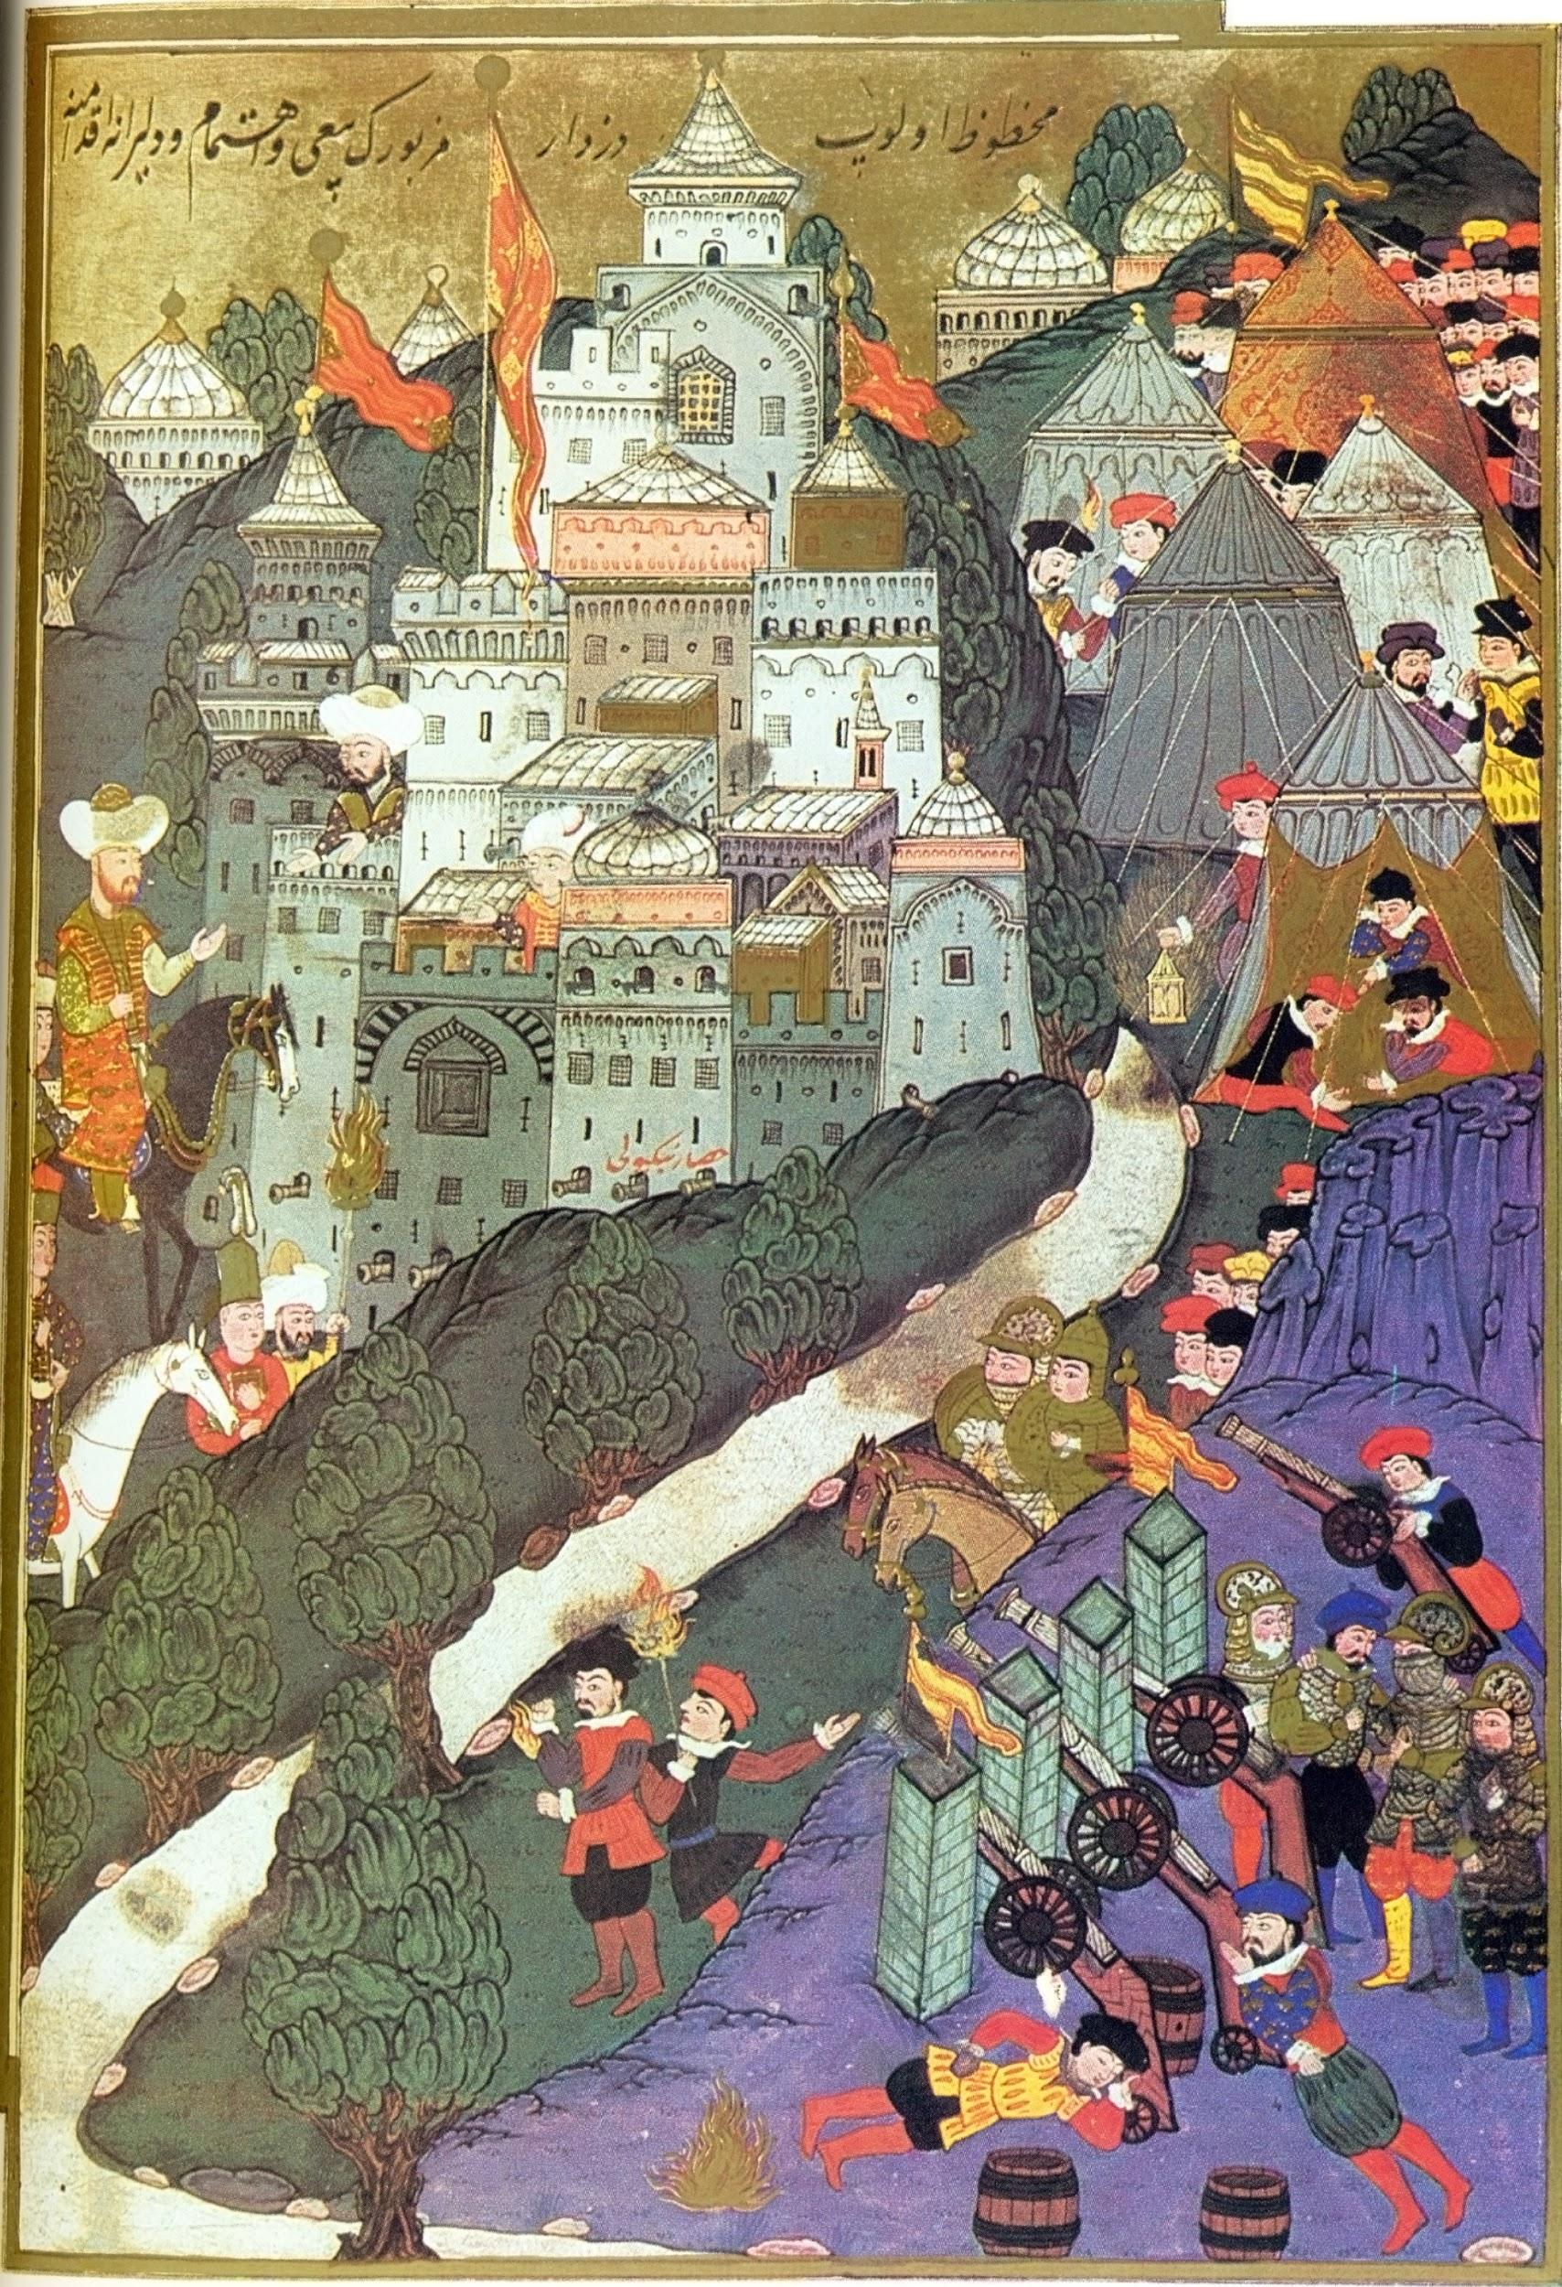
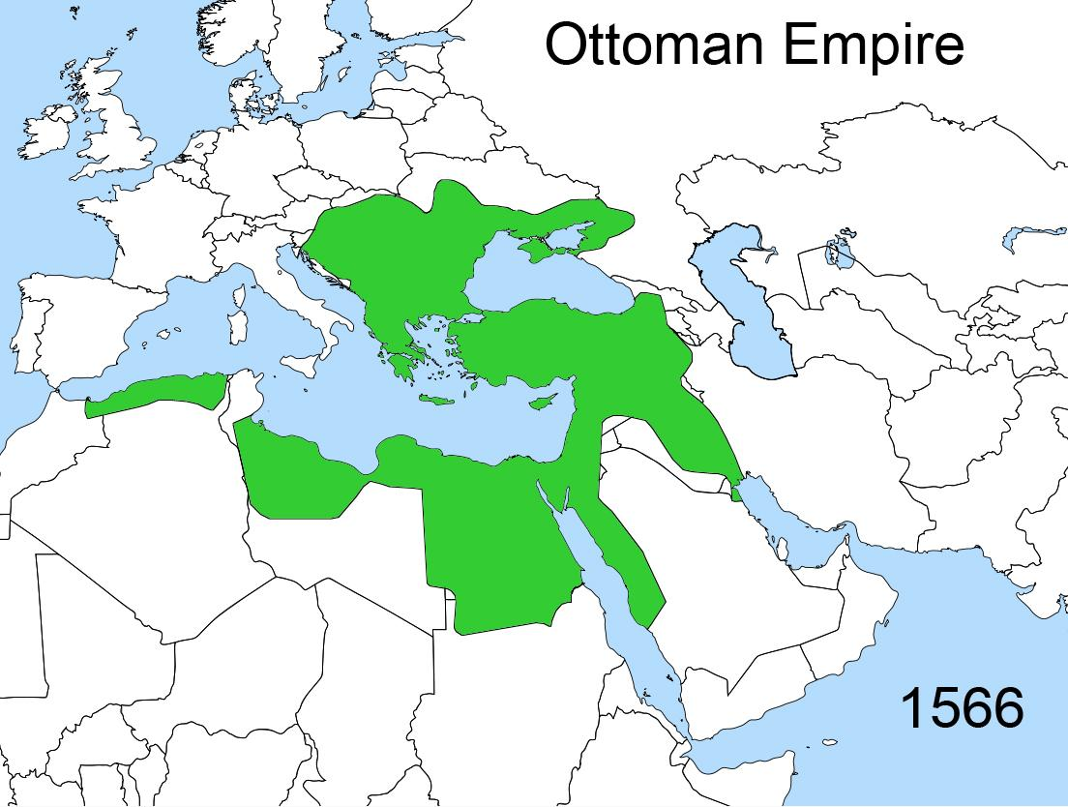
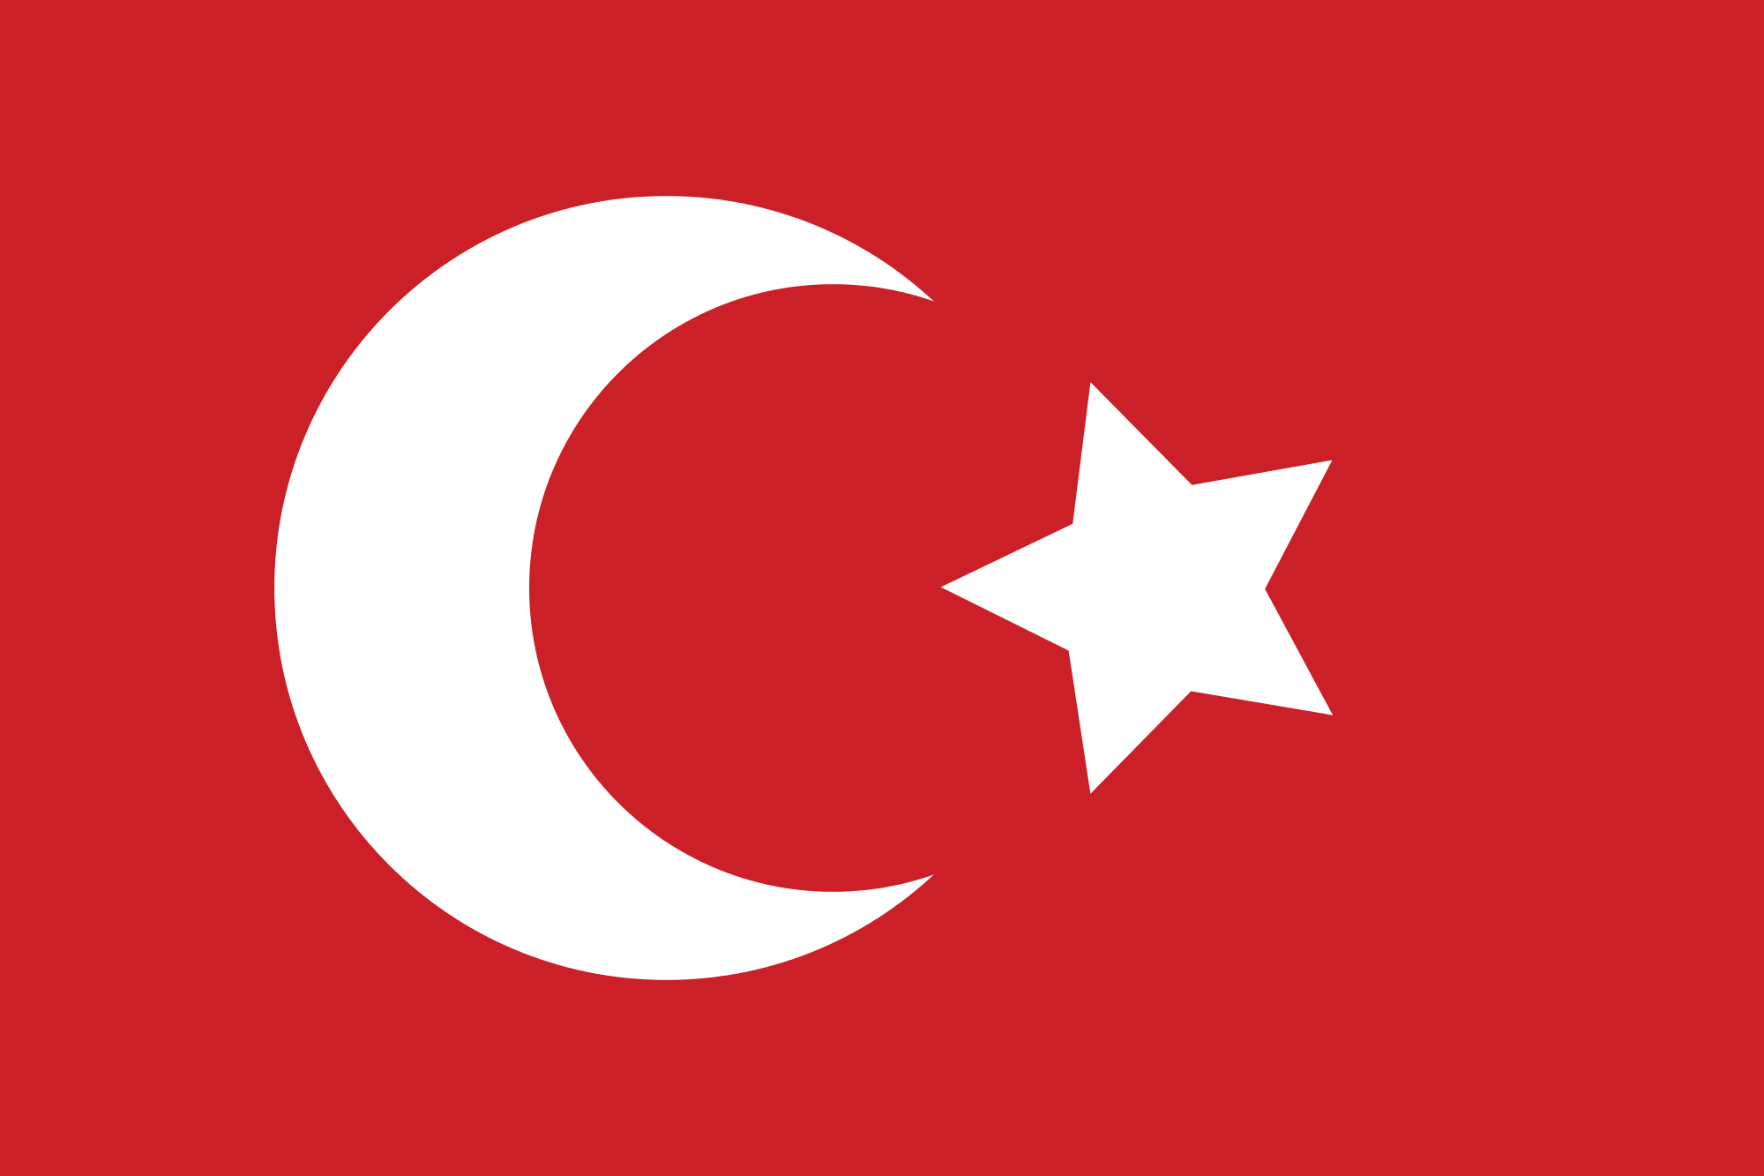

Slide 4
Serfdom
In the East political factors caused surdom to last longer than in western europe
East Lords= More Power
The political power was weaker for peasants and landlords took power away from peasants.
The monarchy would post taxes without consent
Standing armies were set up to police the countryside,

Slide 5
Austria
Austrian Habsburgs originally served as the Holy Roman Emperors until the end of the Thirty Years’ War.
The Habsburgs lost the authority they had as holy Roman Emperors over other German States
The Austrian Empire at the time consisted of Lower/Upper Austria, Carinthia, Carinola, Styria, Tyrol, Bohemia as well as parts of Hungary.
Expansionism was encouraged by Austrian leaders but was soon challenged by the Ottoman Empire.
Centrilization of government in hereditarial German-speaking provinces of Empire.

Slide 6
Rising Conflicts between Islam and Christendom
The ever-growing power/tide of Islam and the Ottoman Empire began to spread fear among Europe, especially the Christendom of Europe:
The spread of Islam threatened the spread of Christianity and the lives of many more.
The opening up of several areas allowed for the invasion of Central Europe by the Ottomans.
Strong possibilities of war between Christianity and Islamic states was very high.

