Slide 1
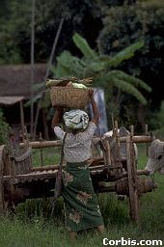


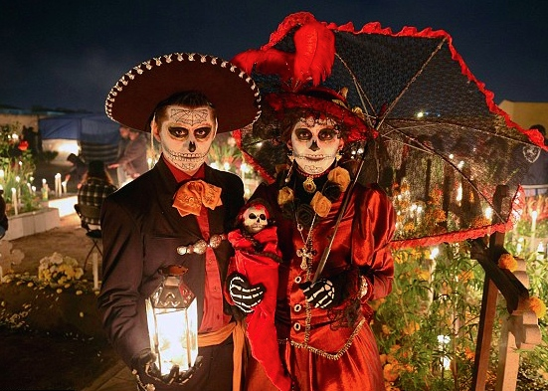
Folk and Popular Culture
Woman with Oxcart, Myanmar
Dia de los muertos, Oaxaca, Mexico
Nicki Minaj and T-Swift- worldwide

Slide 2
Important Terms
Custom – frequent repetition of an act until it becomes characteristic of a group of people..
Habit – repetitive act performed by an individual.
Folk Culture – traditionally practiced by a small, homogeneous, rural group living in relative isolation.
Popular Culture – found in a large, heterogeneous society that shares certain habits despite differences in personal characteristics.
Material Culture – the physical objects produced by a culture in order to meet its material needs: food, clothing, shelter, arts, and recreation.

Slide 3
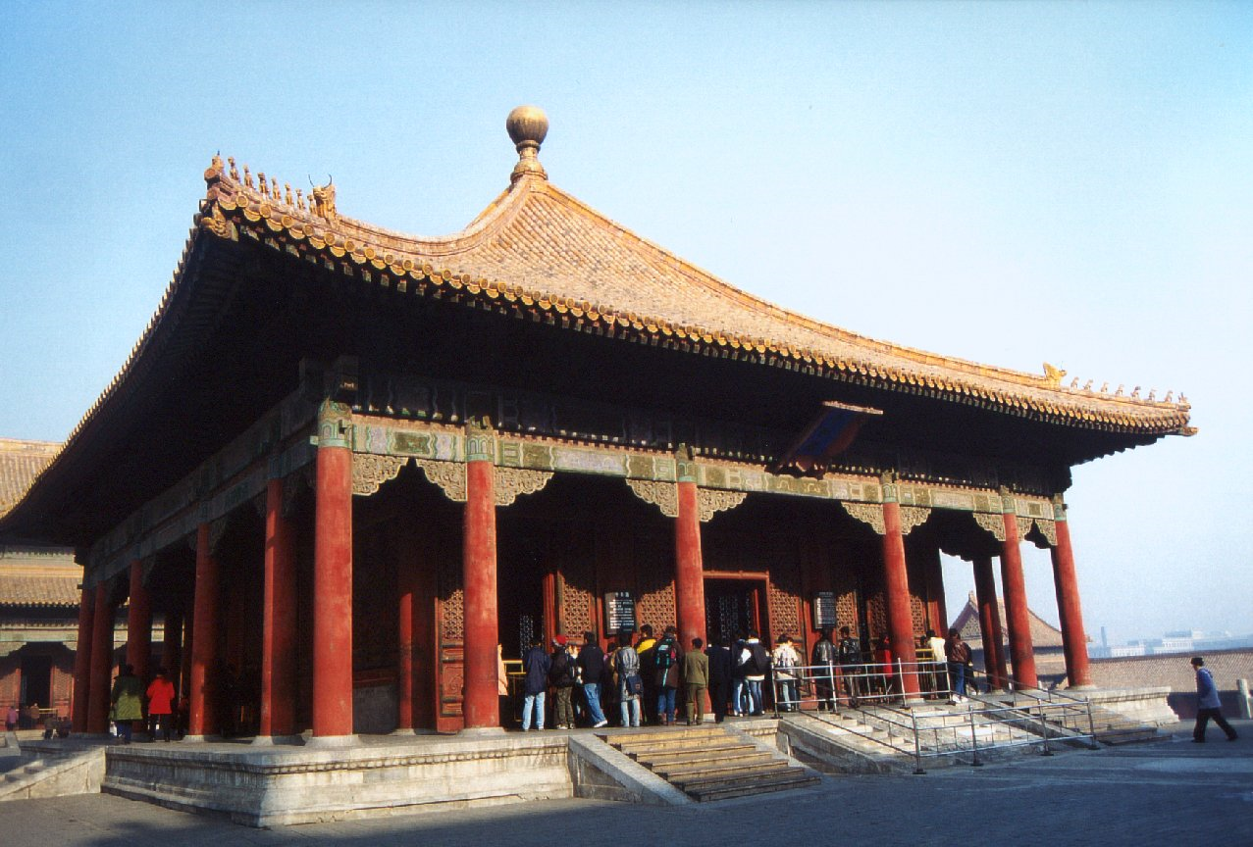
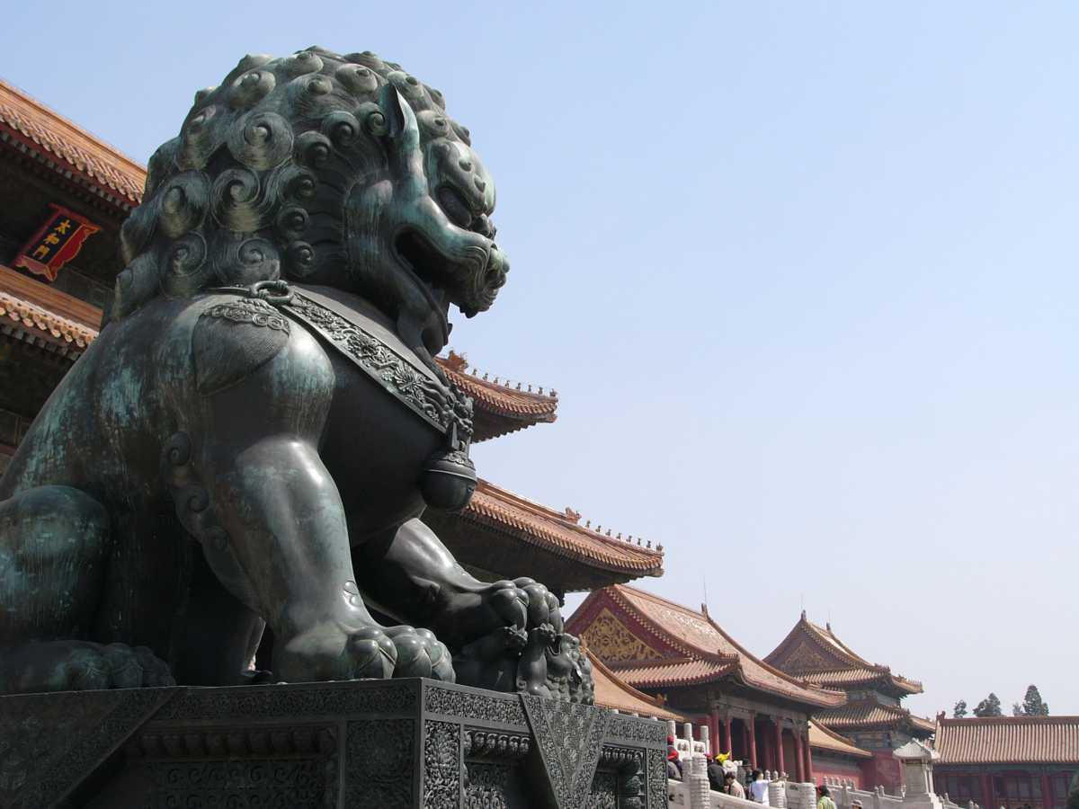
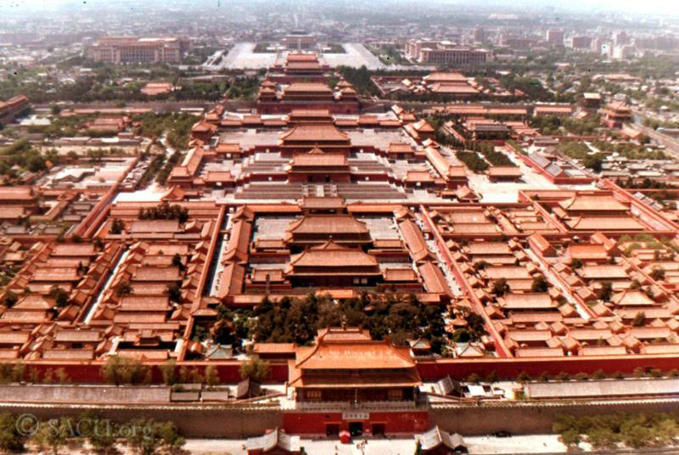
The Forbidden City
Beijing, China

Slide 4
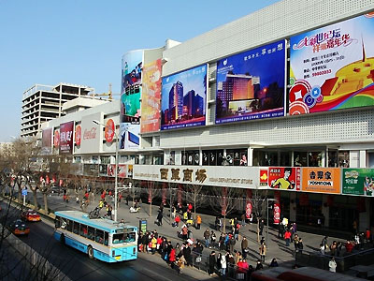
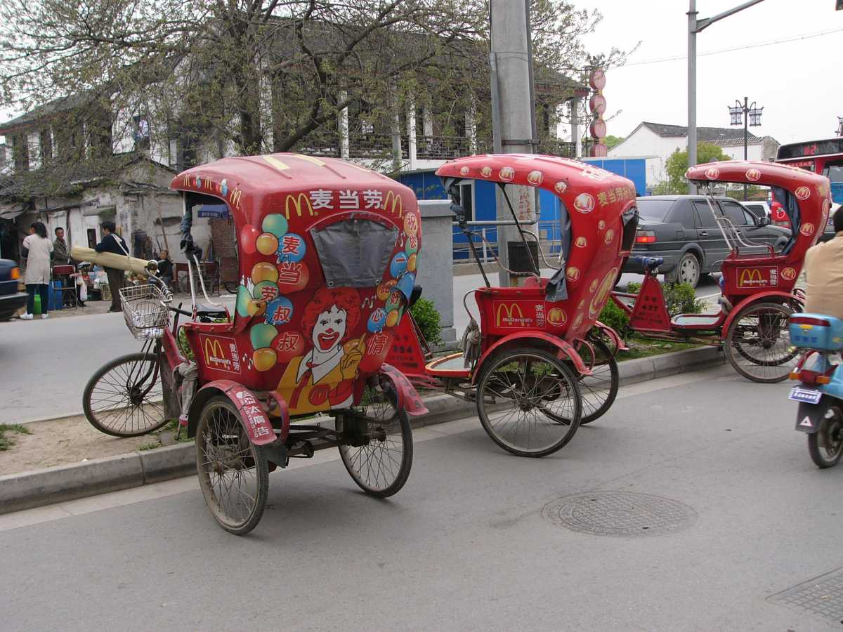
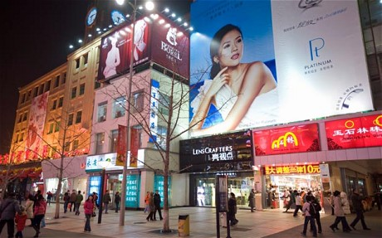
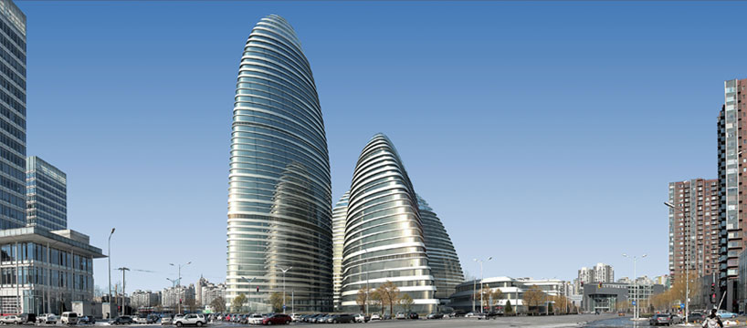

Slide 5
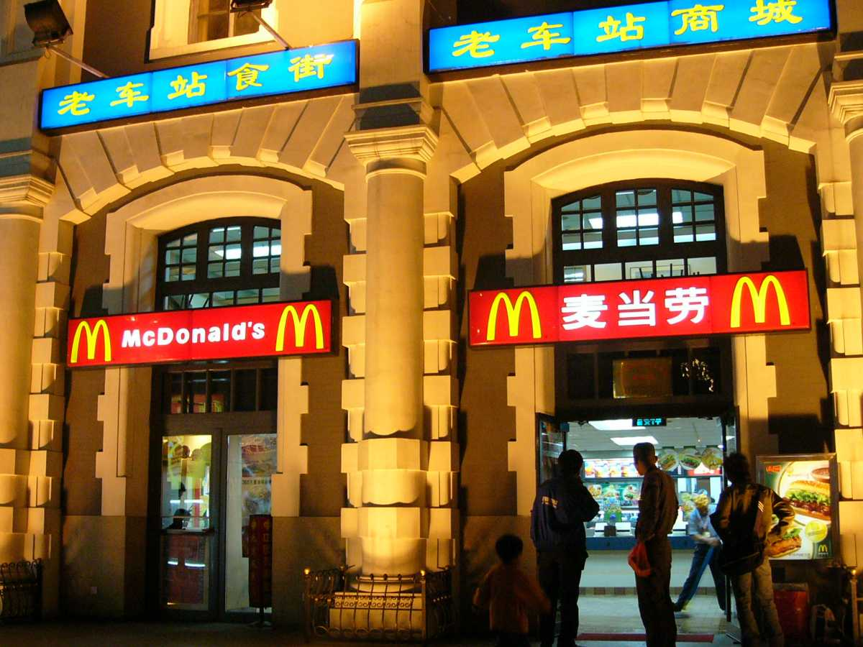
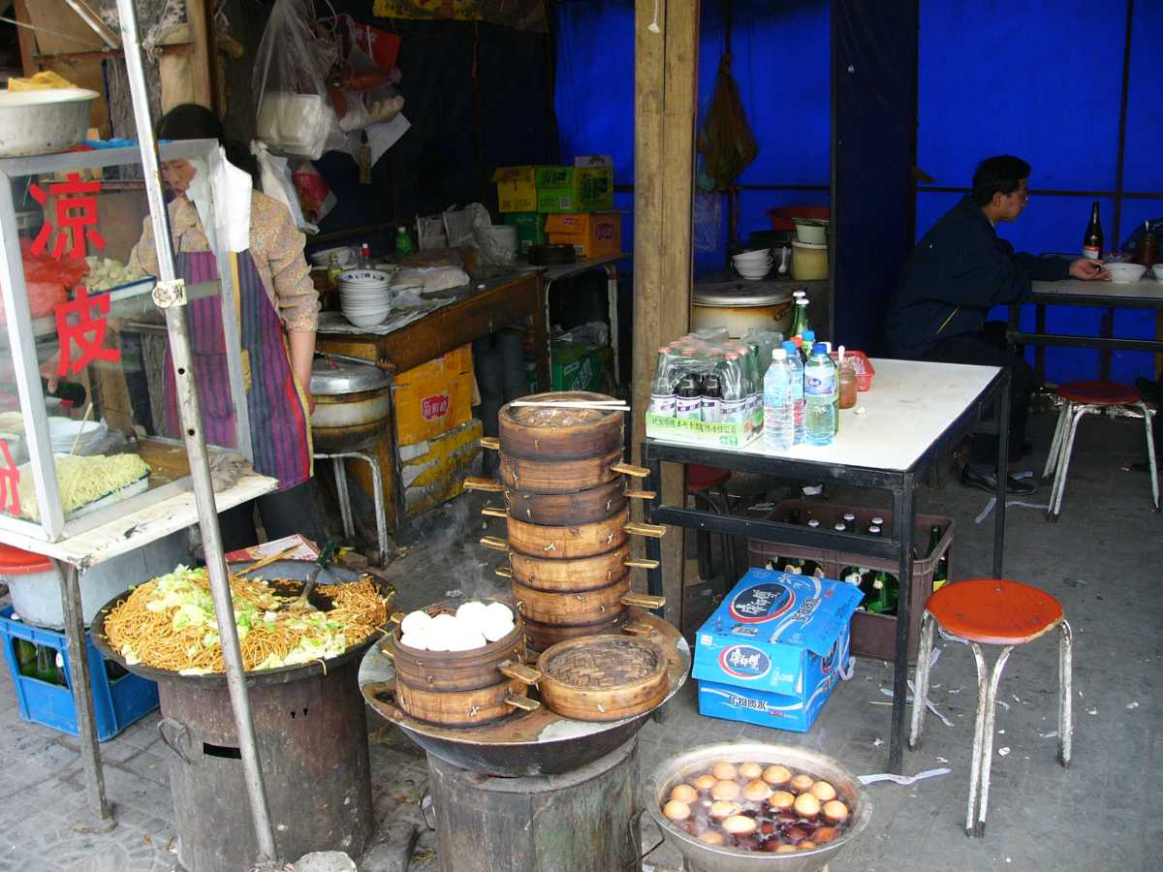
Beijing, China

Slide 6
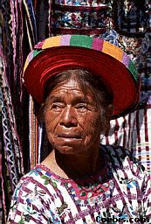

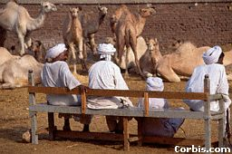
Folk Culture – rapidly changing and/or disappearing throughout much of the
world.
Guatemalan Market
Portuguese Fishing Boat
Turkish Camel Market

Slide 7
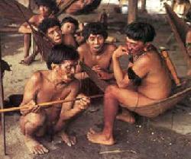
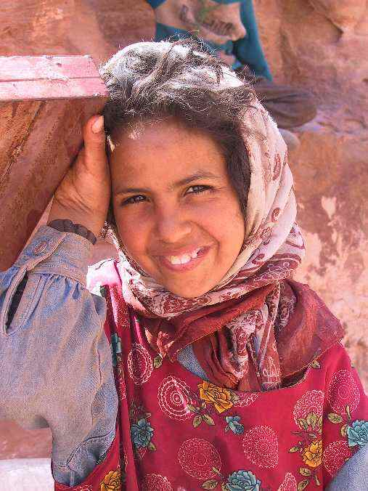
Folk Culture
Stable and close knit
Usually a rural community
Tradition controls
Resistance to change
Buildings erected without architect or blueprint using locally available building materials
anonymous origins, diffuses slowly through migration. Develops over time.
Clustered distributions: isolation/lack of interaction breed uniqueness and ties to physical environment.

Slide 8
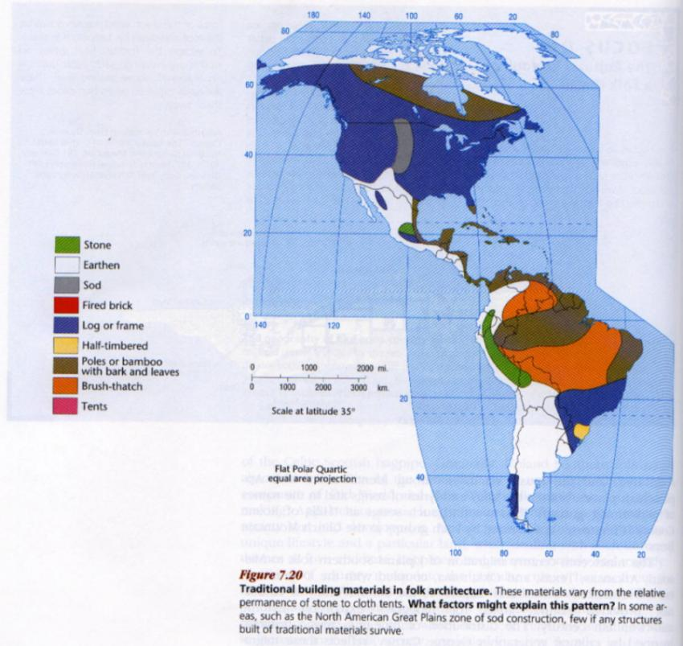
FOLK ARCHITECTURE
Effects on Landscape: usually of limited scale and scope.
  Agricultural: fields, terraces, grain storage
  Dwellings: historically created from local materials: wood, brick, stone, skins; often uniquely and traditionally arranged; always functionally tied to physical environment.

Slide 9
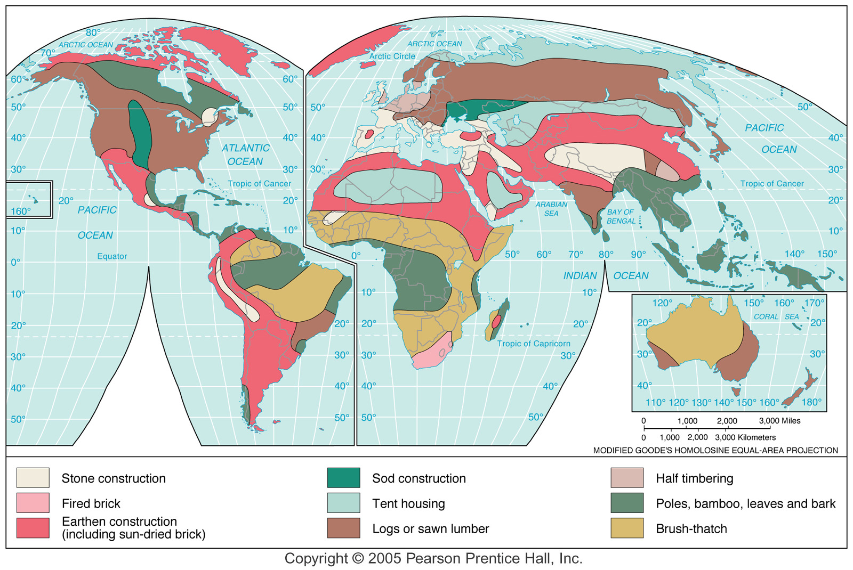
FOLK ARCHITECTURE

Slide 10
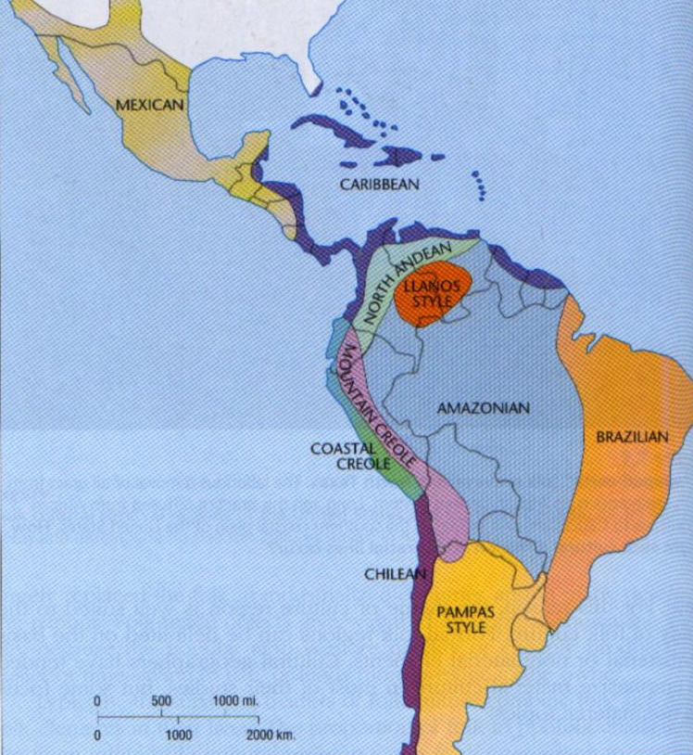
FOLK FOOD
How did such differences develop?

Slide 11
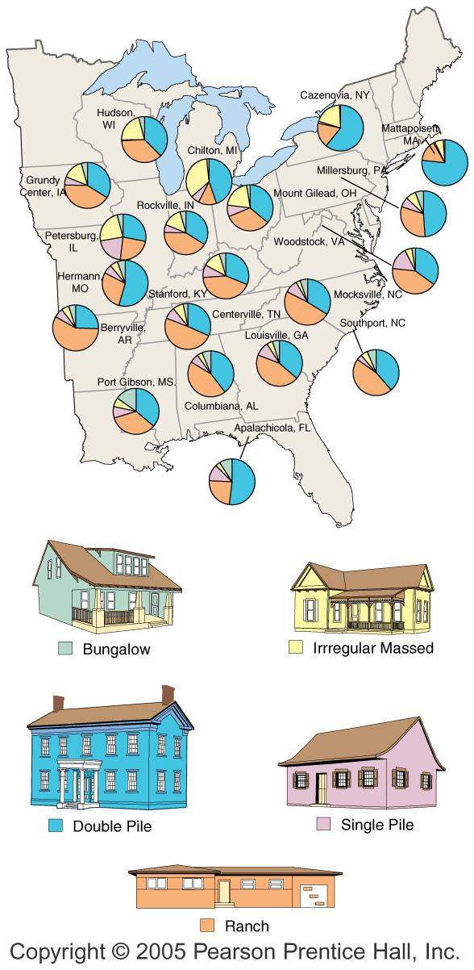
U.S. House Types by Region
Fig. 4-1-1: Small towns in different regions of the eastern U.S. have different combinations of five main house types.

Slide 12
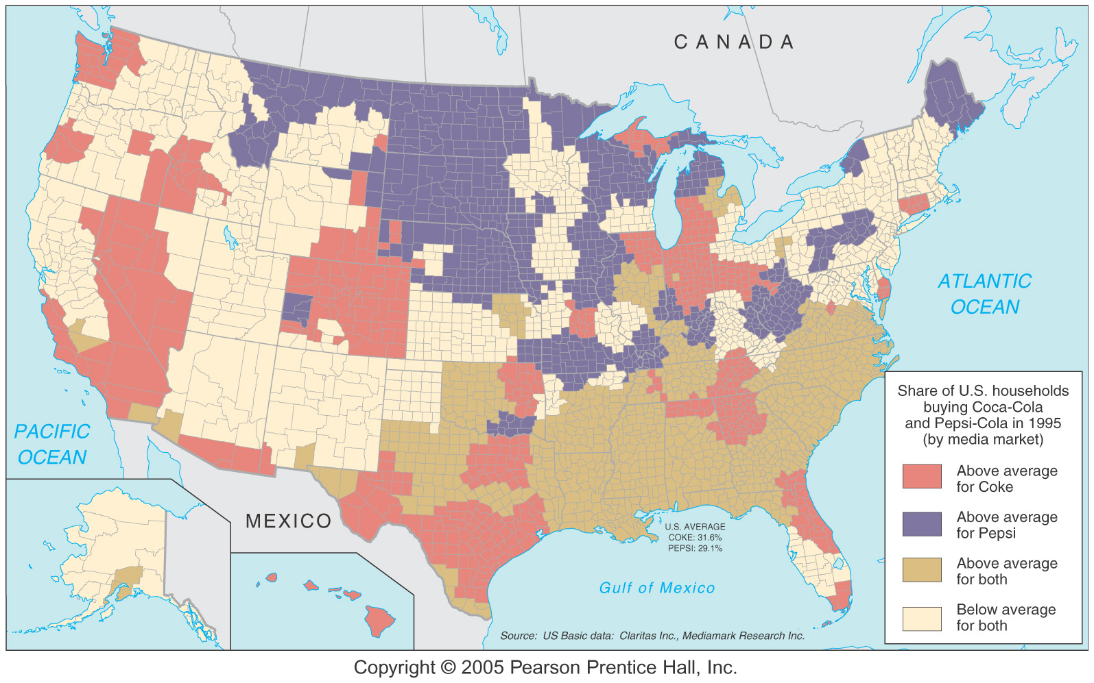

Slide 13
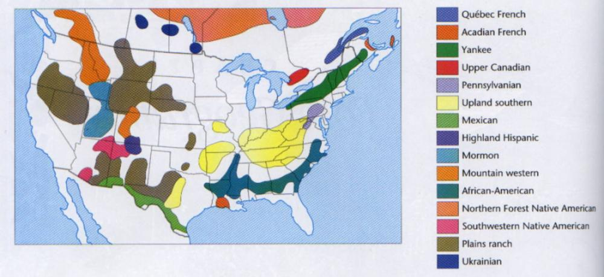
North American Folk Culture Regions

Slide 14
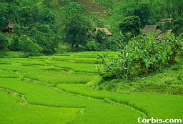
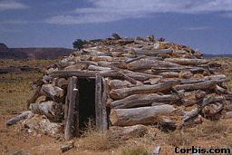
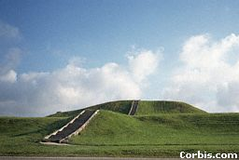
Folk Culture and the Land
Terraced Rice Fields, Thailand
Hogan, Monument Valley, AZ
Cohokia Mounds, Illinois

Slide 15
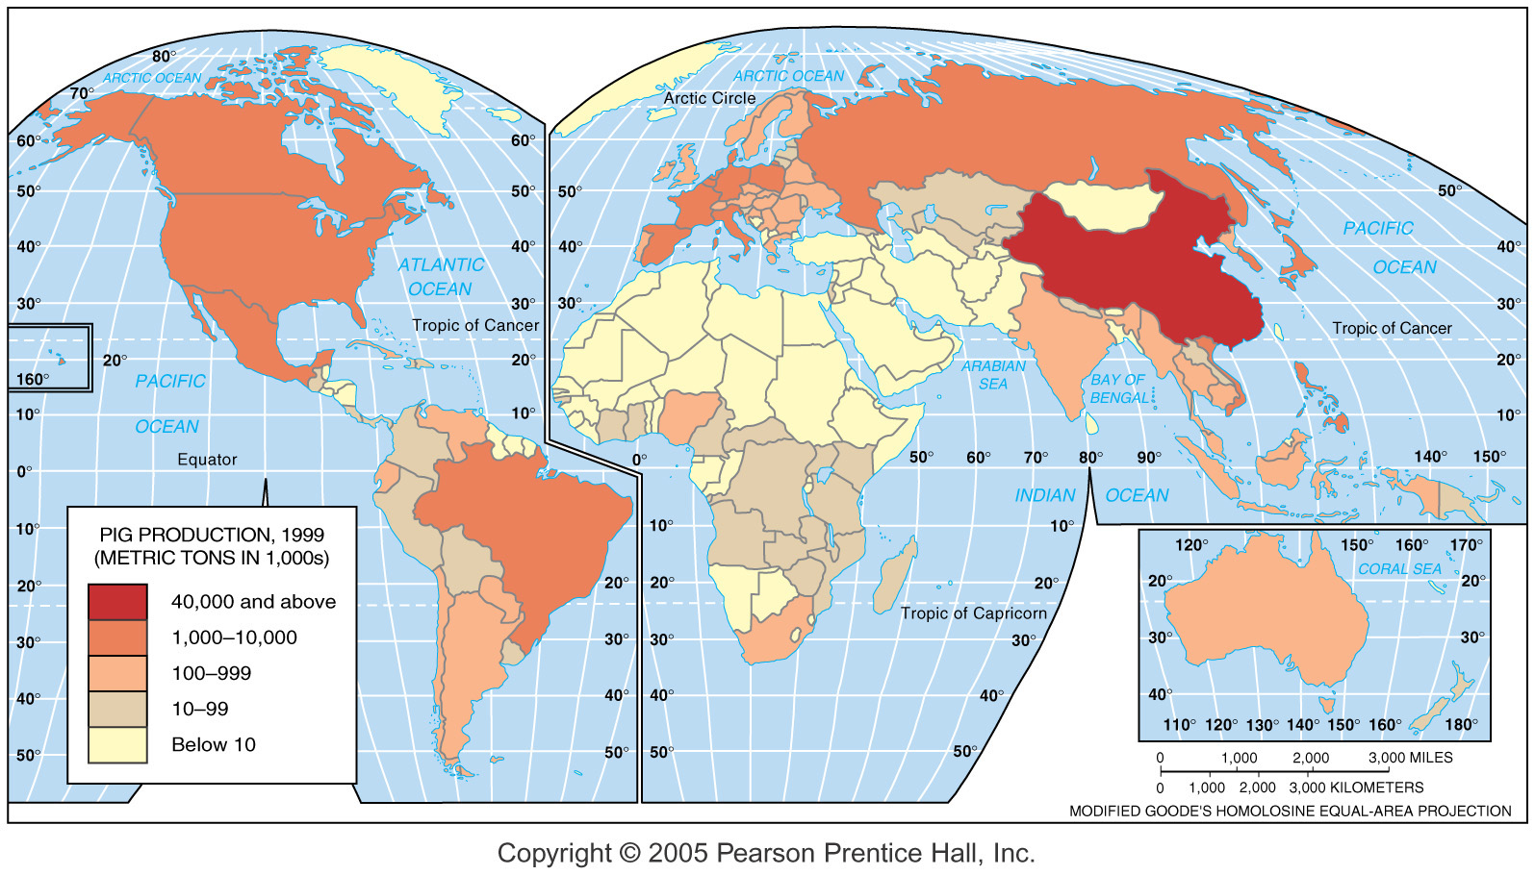
Hog Production and Food Cultures
Fig. 4-6: Annual hog production is influenced by religious taboos against pork consumption in Islam and other religions. The highest production is in China, which is largely Buddhist.

Slide 16
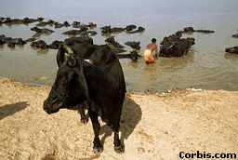
Taboo – a restriction on behavior imposed by social custom.
Food Taboos: Jews – can’t eat animals that chew cud, that have cloven feet; can’t mix meat and milk, or eat fish lacking fins or scales; Muslims – no pork; Hindus – no cows (used for oxen during monsoon)
Washing Cow in Ganges

Slide 17
Popular Culture
Wide Distribution: differences from place to place uncommon, more likely differences at one place over time.
Housing: only small regional variations, more generally there are trends over time
Food: franchises, cargo planes, superhighways and freezer trucks have eliminated much local variation. Limited variations in choice regionally, esp. with alcohol and snacks. Substantial variations by ethnicity.

Slide 18
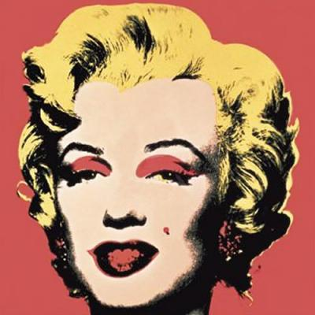
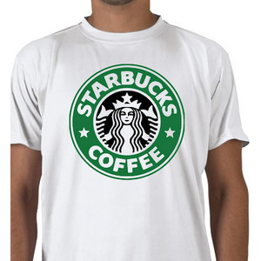



Popular Culture
Ex: clothing fads Jeans
have become valuable
status symbols in many regions including Asia and Russia despite longstanding folk traditions.

Slide 19
Popular Culture
Effects on Landscape: breeds homogenous, “placeless” landscape
    Complex network of roads and highways
    Commercial Structures tend towards ‘boxes’
    Dwellings may be aesthetically suggestive of older folk traditions
    Planned and Gated Communities more and more common
Disconnect with landscape: indoor swimming pools, desert surfing.

Slide 20
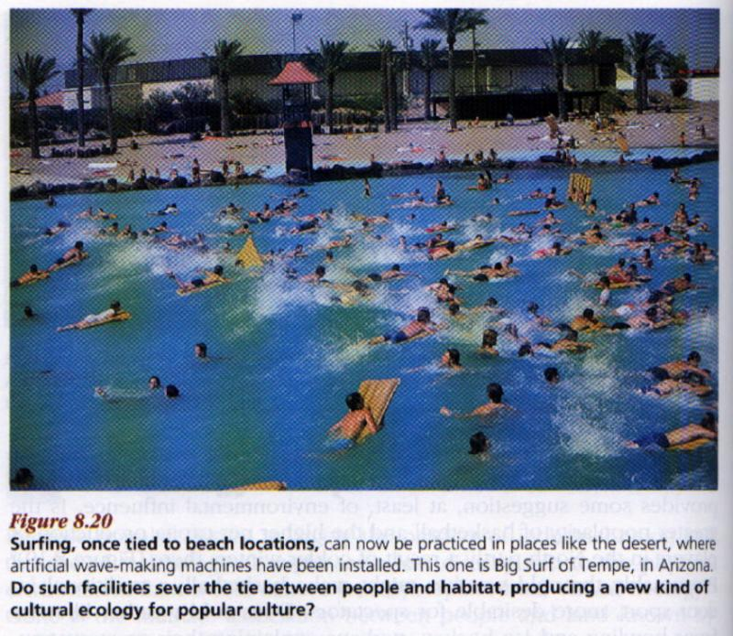
Surfing in Tempe, Arizona
Are places still tied to local landscapes?

Slide 21
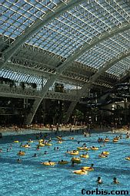
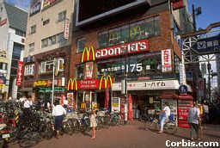
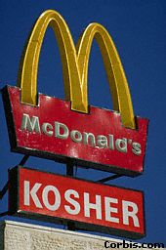
McDonald’s, Tokyo, Japan
Swimming Pool, West Edmonton Mall, Canada
McDonald’s, Jerusalem

Slide 22
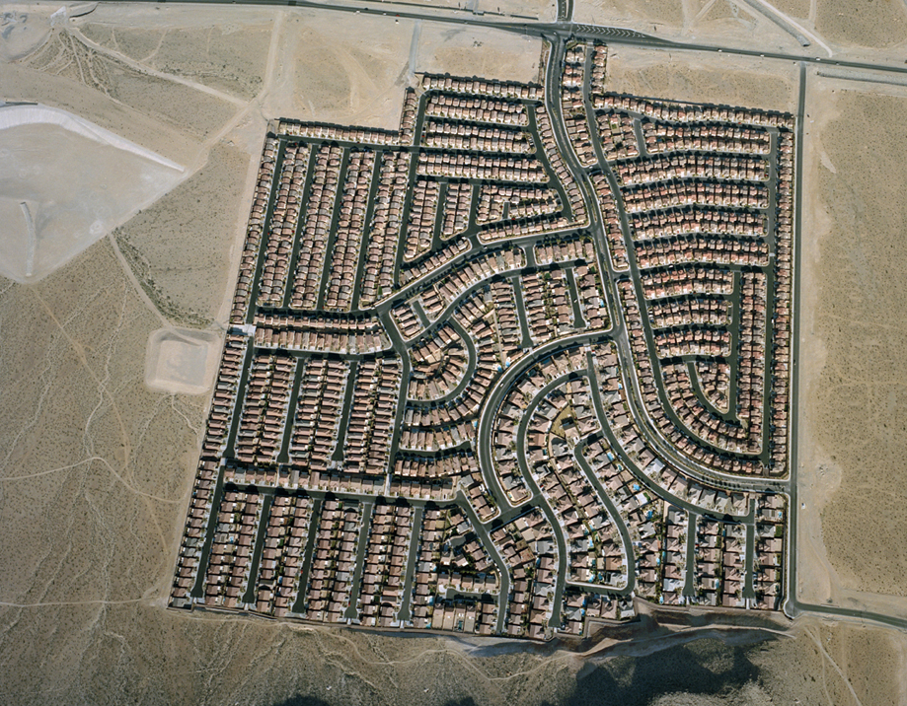

Slide 23
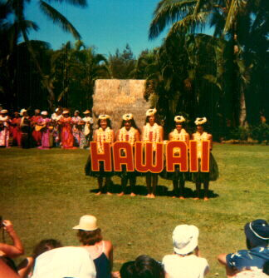
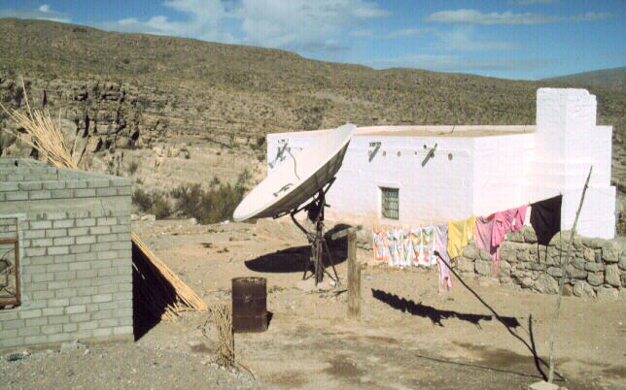
Problems with the Globalization of Culture
Often Destroys Folk Culture – or preserves traditions as museum pieces or tourism gimmicks.
    Mexican Mariachis; Polynesian Navigators; Cruise Line Simulations
    Change in Traditional Roles and Values; Polynesian weight problems
Satellite Television, Baja California

Slide 24
Problems with the Globalization of Popular Culture
Western Media Imperialism?
  U.S., Britain, and Japan dominate worldwide media.
  Glorified consumerism, violence, sexuality, and militarism?
  U.S. (Networks and CNN) and British (BBC) news media provide/control the dissemination of information worldwide.
  These networks are unlikely to focus or provide third world perspective on issues important in the LDCs.

Slide 25
Environmental Problems with Cultural Globalization
Accelerated Resource Use through Accelerated Consumption
    Furs: minx, lynx, jaguar, kangaroo, whale, sea otters (18th Century Russians) fed early fashion trends
    Inefficient over-consumption of Meats (10:1), Poultry (3:1), even Fish (fed other fish and chicken) by meat-eating pop cultures
    Mineral Extraction for Machines, Plastics and Fuel
    New Housing and associated energy and water use.
    Golf courses use valuable water and destroy habitat worldwide.
Pollution: waste from fuel generation and discarded products, plastics, marketing and packaging materials

Slide 26
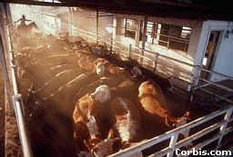
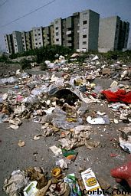
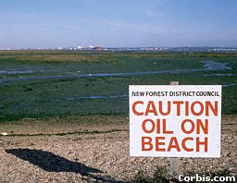

Slide 27
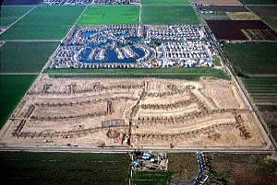
“They’re growing houses in the fields between the towns.”
- John Gorka, Folk Singer

Slide 28
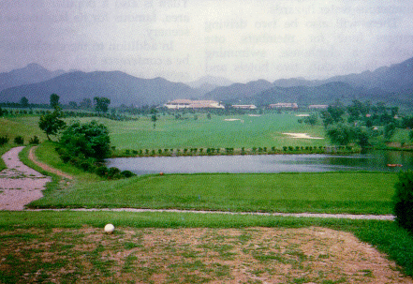
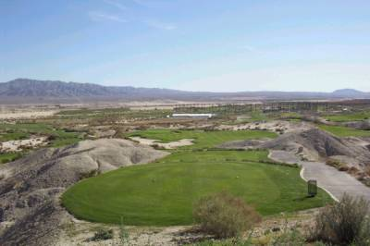
Beijing, China
Palm Springs, CA

Slide 29
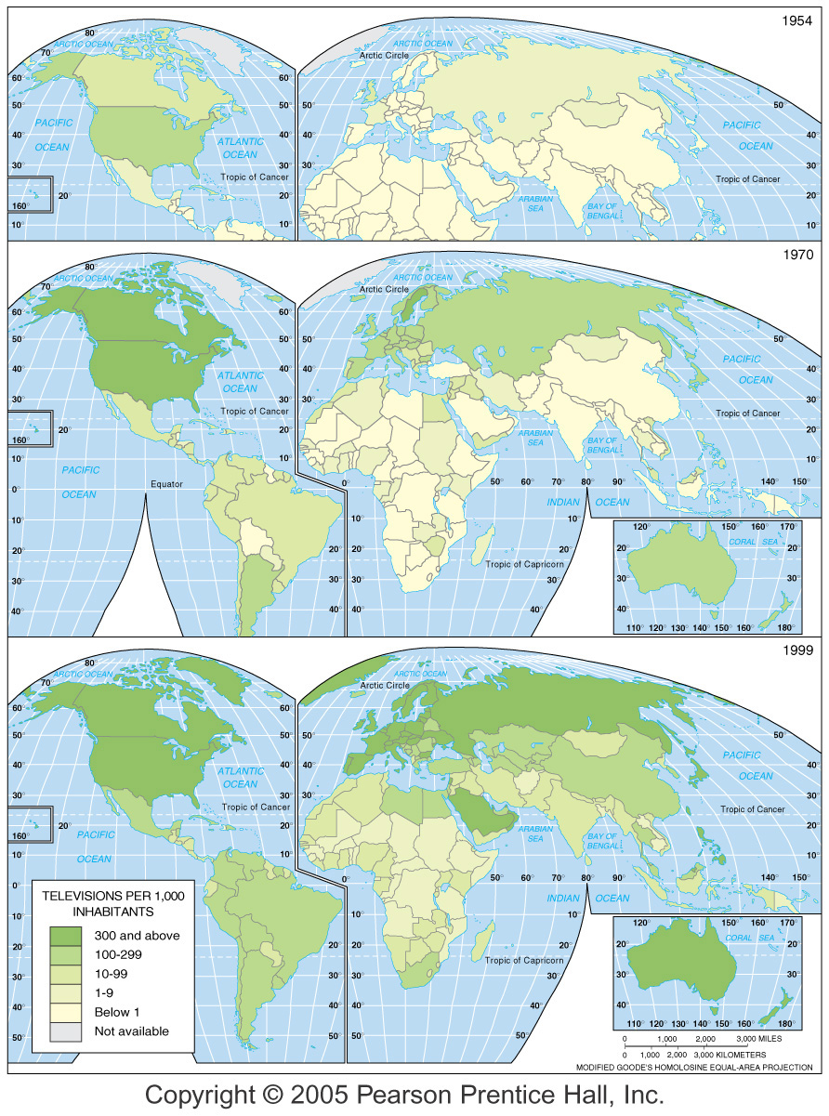
Diffusion of TV, 1954–1999
Fig. 4-14: Television has diffused widely since the 1950s, but some areas still have low numbers of TVs per population.

Slide 30
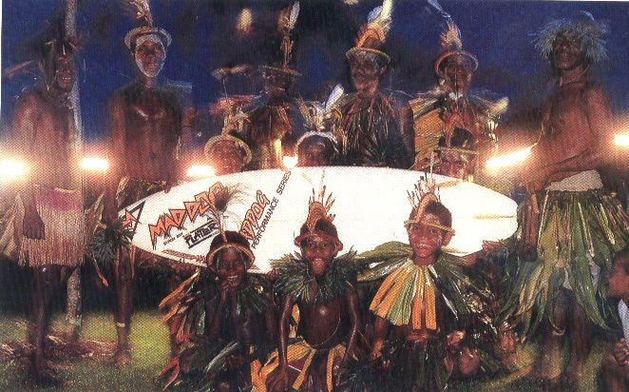
Fiji

Slide 31
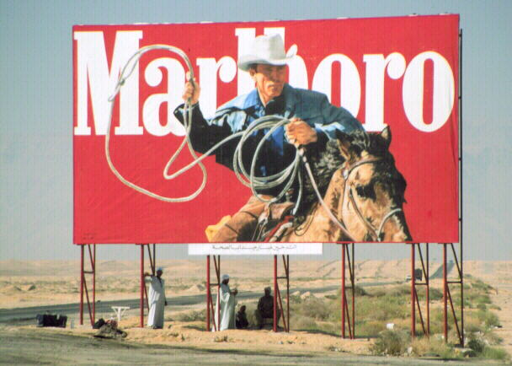
Marlboro Man in Egypt

Slide 32
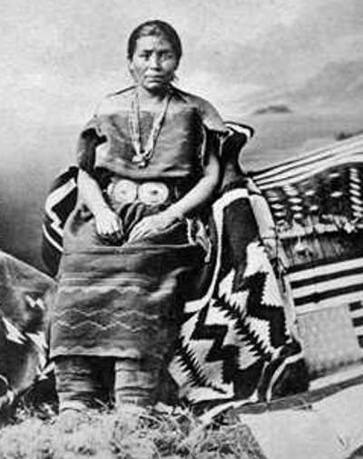
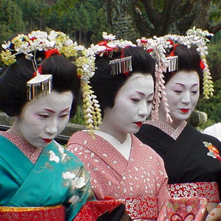
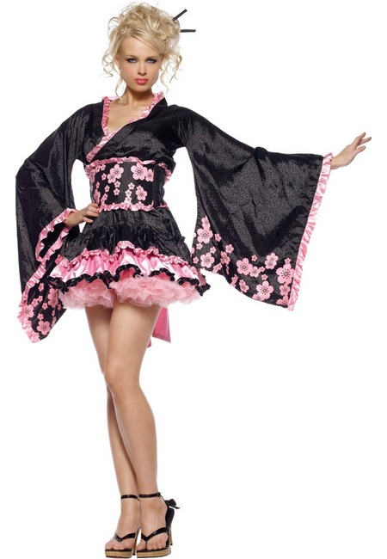

Folk versus Popular

