Slide 1
Exploration and the Atlantic Slave Trade
By: Paul Long

Slide 2
Causes for European Exploration
Economic Expansion
Europeans wanted to expand their markets by finding more resources to sell and produce into goods.
The ability to be able to have more land for people to use to farm foodstuffs and other materials such as beef, wool, and other goods that were always in high demand.
Political Power
Owning more land led to a stronger empire both in the colonies and country.
The countries would have full control of their colonies as well as more power over other countries because of their holdings overseas.
Having more overseas holdings will allow monarchies to be greater than other monarchies who did not have as much or any holdings.
Economic Power
Finding valuable metals such as gold would make the mother countries very rich, allowing for them to far greater economic wealth as opposed to others.
Empires could have far greater production power and access to more materials, allowing them to expand even further.
Religion / White Supremacy
Many empires sought to spread the word of God and Christianize the natives.
Most Europeans saw the natives of the land they conquered as less than human, barbaric, and worse.
They saw it as their duty as “good” Christians to show them the wrongs of their ways.

Slide 3
The Beginning of European Exploration
Exploration started early but did not see much recognition until later. The outward expansion of the Vikings under the rule of Eric the Red and Leif Ericson marked the true beginning while the Muslim Ottoman Turks quickly expanded due to their sheer Muslim military strength.
Early European exploration marked the beginning of a new age in Europe. The empire that spearheaded overseas expansion was Portugal, who was currently under the rule of Prince Henry “the Navigator”. He had annual expeditions that he sent down the western coast of Africa, managing to muscle in on the trade of gold between the Muslims and West Africans. The Portuguese began to establish trading posts as they pushed farther and farther down the western coast of Africa.

Slide 4
The Beginning
Soon after hearing the successes of Portugal, countries such as Spain, France, and England. Countries that had the funds began to put money towards expeditions so that they clued be the first to gain uncharted land as well as open up new possibilities for trade. Because of this, there was an explosion of explorers being funded by empires to sail into the New World.
With all of these explorers now going to the New World, it was becoming increasingly difficult to take over land or even figure out where to go .

Slide 5
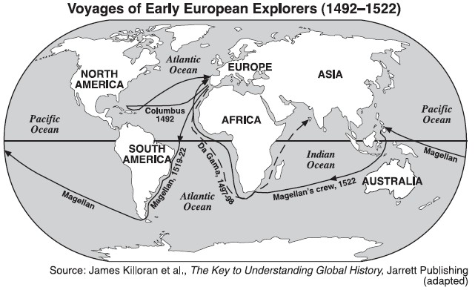
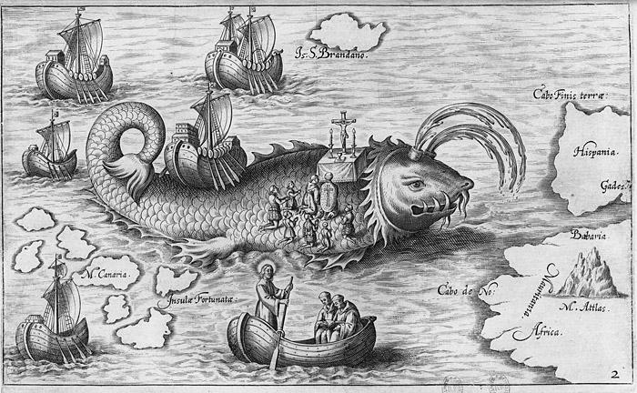
Maps of Early Exploration / Beliefs of Early Europeans

Slide 6
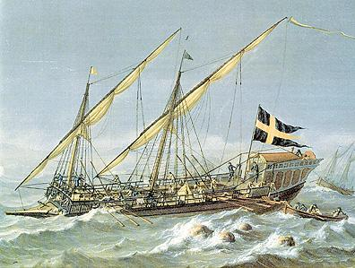
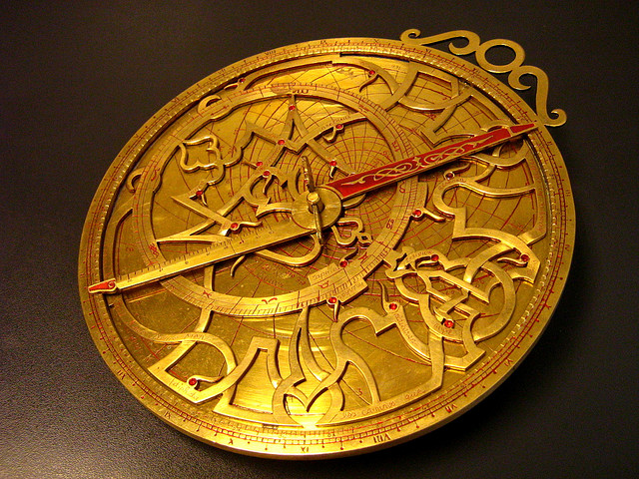
Technological Advancements
On top of that, technological developments and outbreaks were one of the keys to Europe’s mass exploration. These technological advancements allowed Europeans to sail with better precision, better understanding of geography and time, and more.

Slide 7
Technological Advancements
Some technological advancements include:
Caravel - A lighter, three masted ship that could hold more cargo, more firepower, and was much more maneuverable as opposed to ships such as the galley.
Nocturnal - Allowed for sailors to determine the hour of night by finding the progress of certain stares around the polestar, or center aperture.
Astrolabe - Used to determine the altitude of the sun and other celestial bodies. This allowed for sailors to determine their altitude (position north or south relative to the equator).
Cannon - The new and improved cannon now added more protection for those out at sea. This alongside improvements in shipbuilding allowed for sailors to be more at ease when sailing.

Slide 8
Motives of the Explorers
Many explorers sought fame and fortune out on the high seas. There could be anything out there in the uncharted lands of the Atlantic. Especially in Spain, becoming an explorer could be their way out of limited political and economic opportunities (the Spanish upper class surprisingly could not participate in much commercial ventured such as manufacturing). Yet, not all explorers had money.
For the most part, nobody could really afford the extensive sums of expenses of various voyages, and these could only be sponsored by the government. The government had these funds, especially in thr case of Portugal or the Netherlands, due to overseas trade and commerce. Growing rich was, quite frankly, the main reason why so many set out on expeditions, after all.

Slide 9
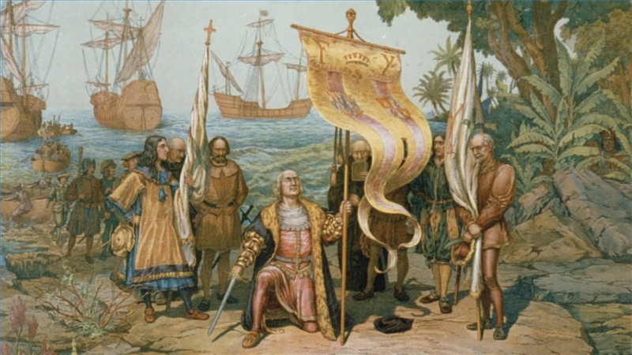

Slide 10
Spanish Dominance
Soon enough, the Spanish began to dominate overseas exploration. The Spanish monarchy greatly funded exploration, especially after the successes that the conquistadors had in South and Central America. With the finding of American silver as well as other precious materials, Spain economy quickly boomed. This led to a sharp increase in Spain population, allowing them to expand even farther than before.

Slide 11
The Columbian Exchange
The Columbian Exchange had very profound effects on Europe, the Americas, and everyone else that was involved. Among the most profound were the biosocial effects that took place as a result of the bringing of crops and animals back and no forth. Crops such as maize, potatoes, tomatoes, pumpkins, and more found their way into Europe through the ships of explorers and merchants. The introductions of horses and other animals to the New World greatly improved the Native Americans hunting ability as well as farming ability. Yet, the biggest effect of this was the introduction of African slaves.

Slide 12
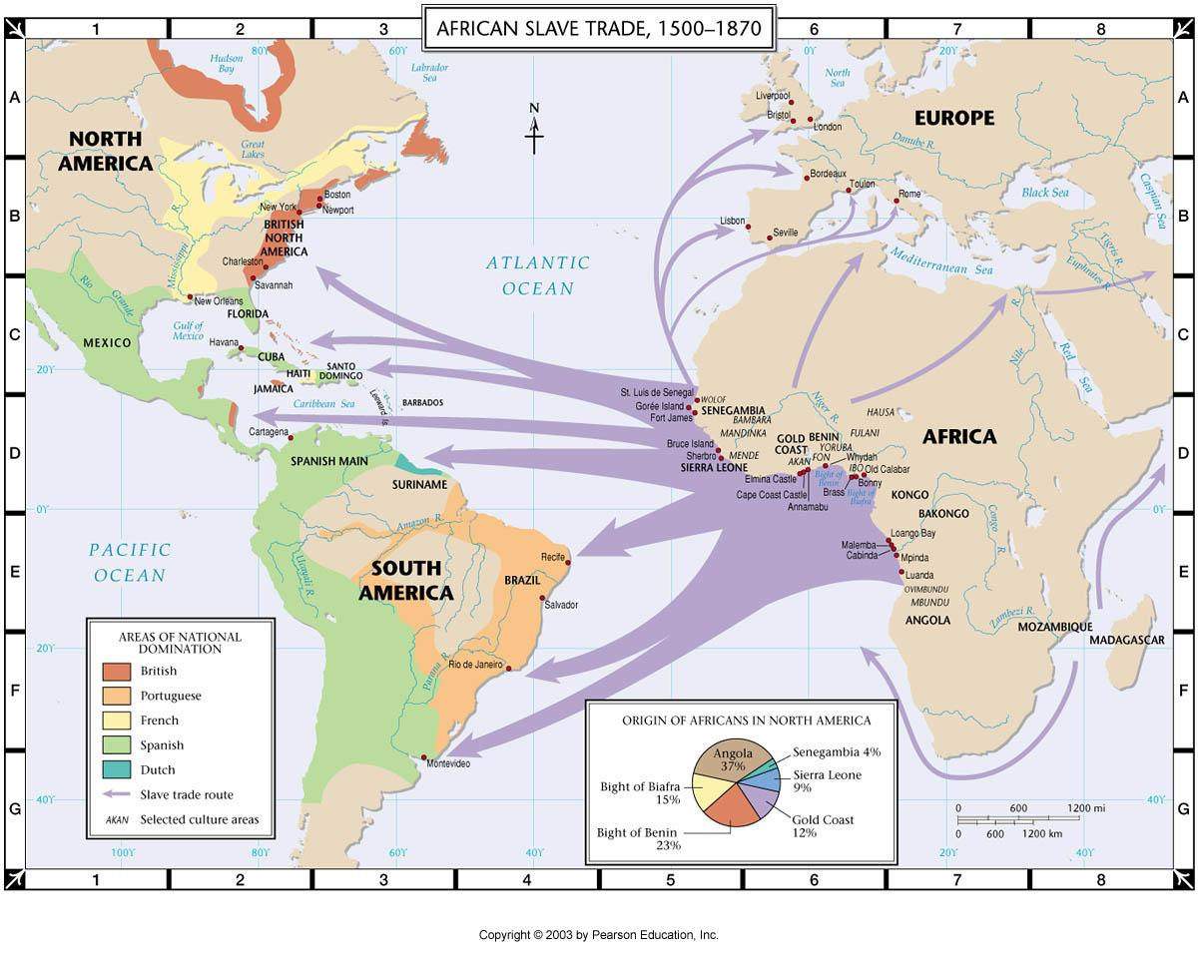
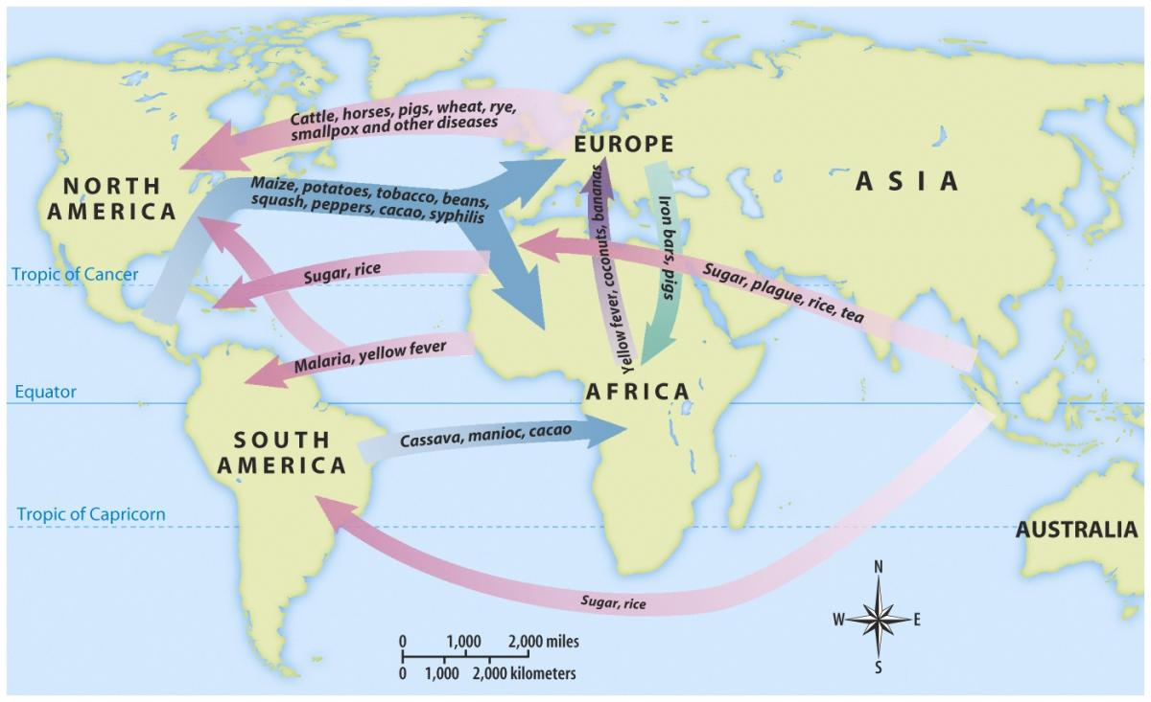
Columbian Exchange and Atlantic Slave Trade

Slide 13
Slavery and Administration
To start off, slavery has been around for fora long while before the Europeans started using Africans. Most slaves were those who were conquered by stronger powers or those of descents such as Polish, Eastern Eruopeans, etc. The introduction of African slaves was groundbreaking, stimulating a new market that would last for years upon years. Why use Natives that knew the land more than the white conquerors and who would most often fight back? Many thought it best to use the African slaves on the lands in the Americas. This increased productivity led to many countries’ economies to skyrocket.

